Slide 1
SHWN_DNTS(DANA)
Always key the following, visible in the invoice separator sheet:
Batch ID (68) BAT ID (69) Value/No
Client Code (68) CL CODE (69) SHWN
Scac Code (68) SCAC CODE (69) DNTS

Slide 2
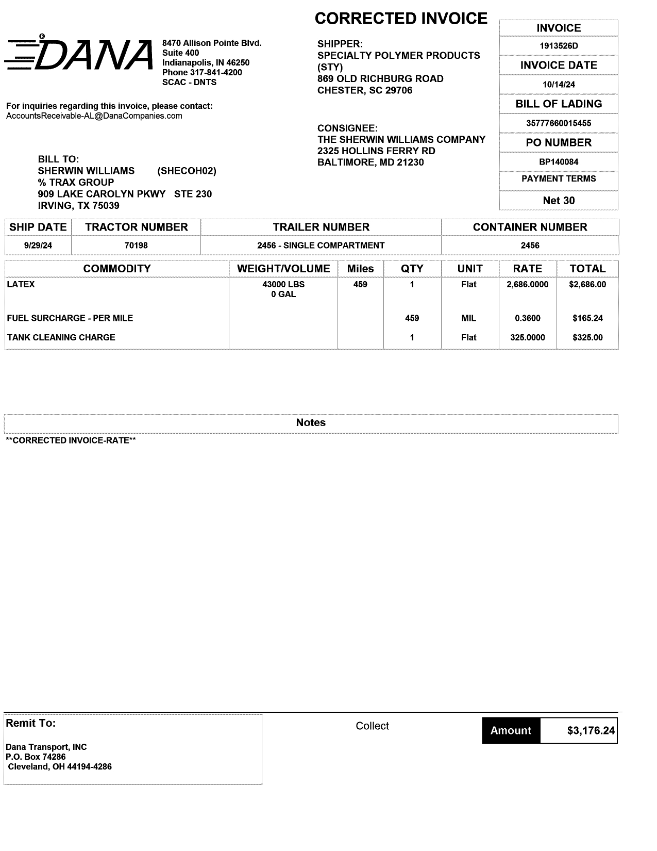
03
27
10
30
68a
02
01 REMIT TO
02 BILL TO
03 INV KEY
10 DATE
27 SHIPPER INV
30 CONSIGNEE INV
42/43 ACTUAL WT/FNCL WT
44/45 UOM
53 VOLUME
54 UOM
48 DISTANCE
61 PICKUP
64 CONTAINER NO
65 CONTAINER TYPE
72 LINE ITEM DESC
74 LINE ITEM QTY
75 LINE ITEM RATE
85 LINE ITEM AMT
68a BOL
68b PO
08/14 INV AMT/FB AMT
68b
61
64
65
64
74
44/45
72
42/43
85
53
54
48
75
08/14
01

Slide 3
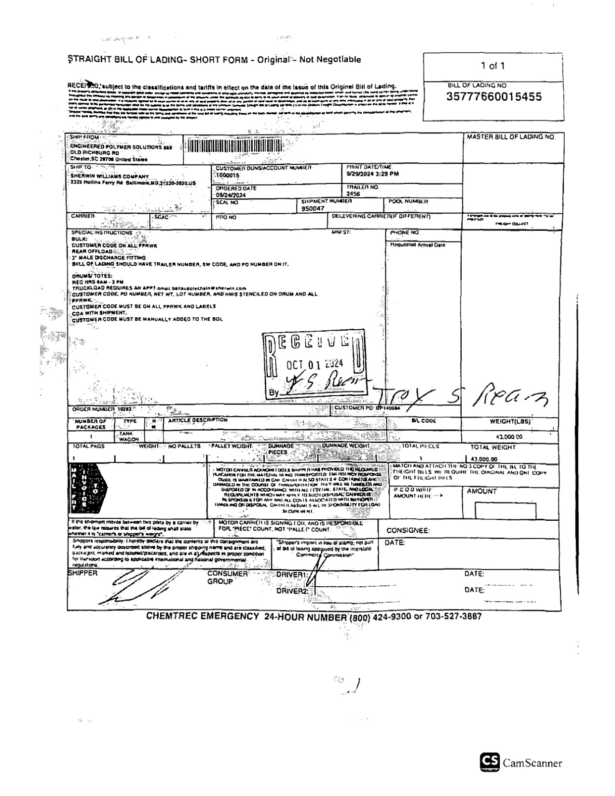
68a
68a BOL
96/97 GROSSWT/NETWT
46/47 PIECES/ PIECES TYPE
46/47
96/97

Slide 4
6
For Verification Table
 | NAME | DATE
DI-64961 | Cidjane J. Locaylocay | 10/17/2024

